Slide 1
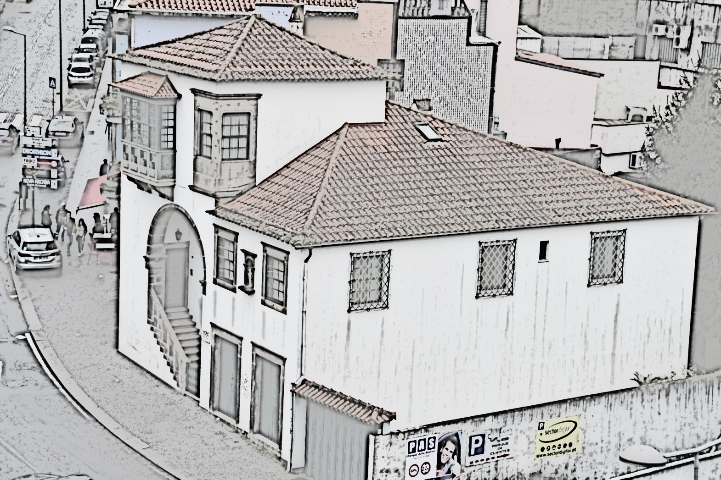
Demolition of facades of buildings in Portugal

Slide 2
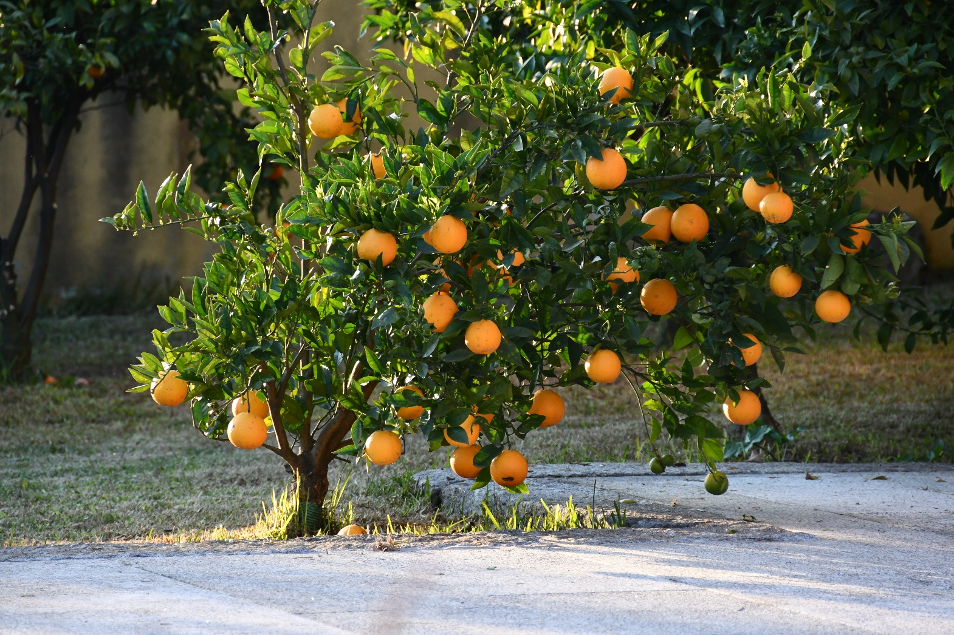
Portugal - the average temperature is 22 °. There are hardly any hot days. It is warm in the south of the country and the annual temperature course is typical of a Mediterranean climate. In winter, the average temperature values ​​are 11-12 ° C, and in summer the average is 24-27 C

Slide 3
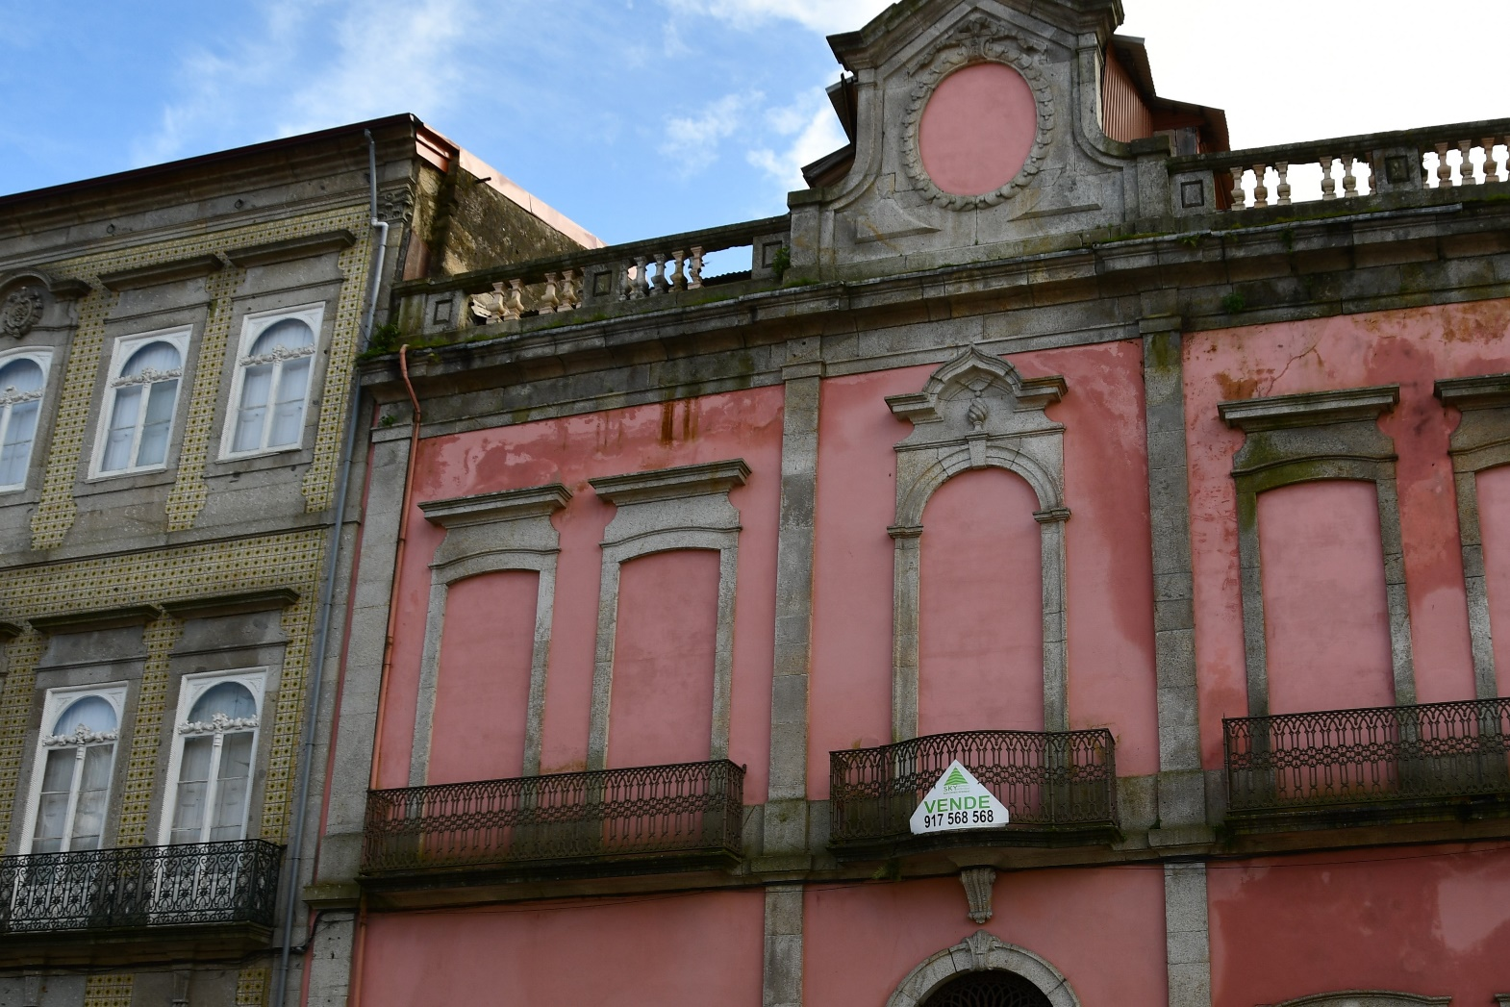
The most common effects of the facade destruction process are dirt and mechanical damage, biological corrosion and the occurrence of salt efflorescence.

Slide 4
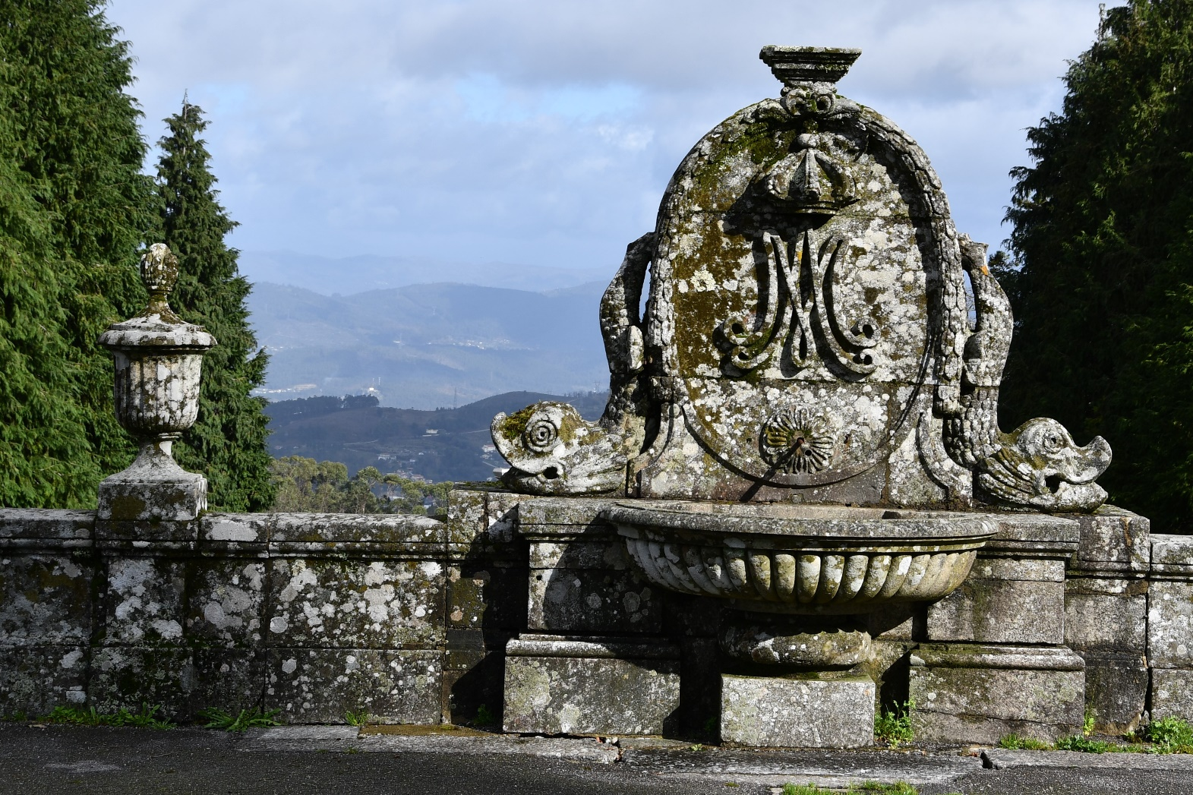
Microbial corrosion is caused by the development of algae (green bloom), mold fungi (gray and black) and lichens.

Slide 5
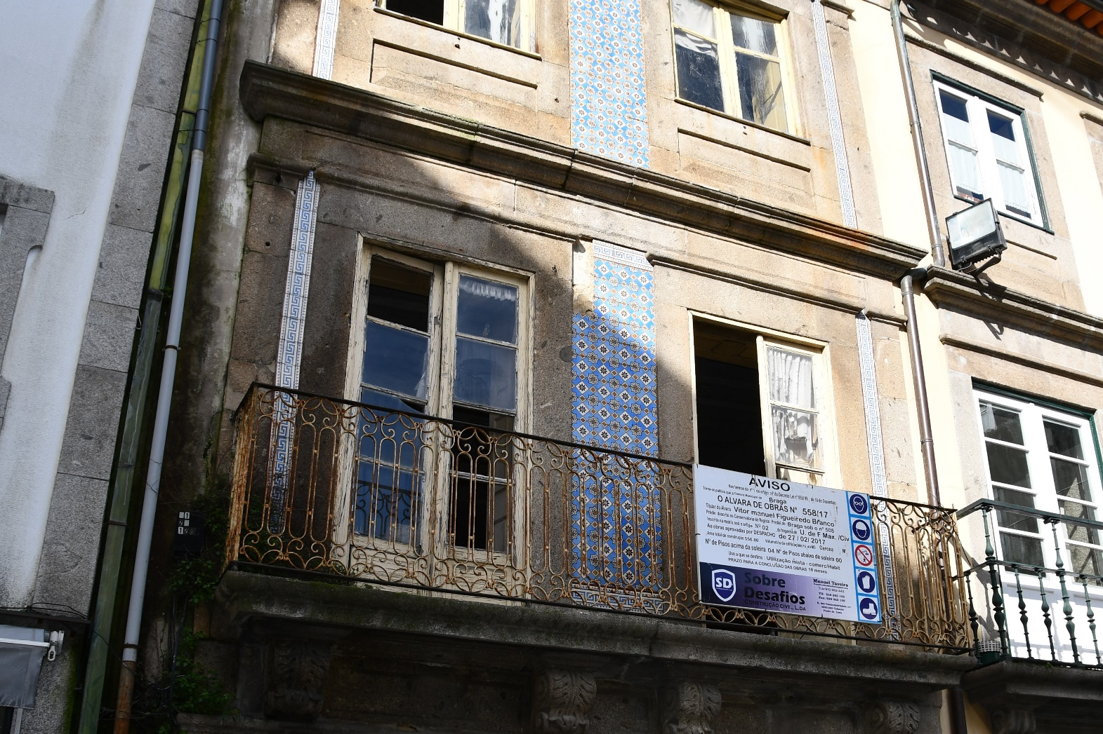
The places that are particularly exposed to damage are: - shaded (bends, faults, walls near growing trees) - at the edge of the roof and next to the pipes draining water from the roof - plinths

Slide 6
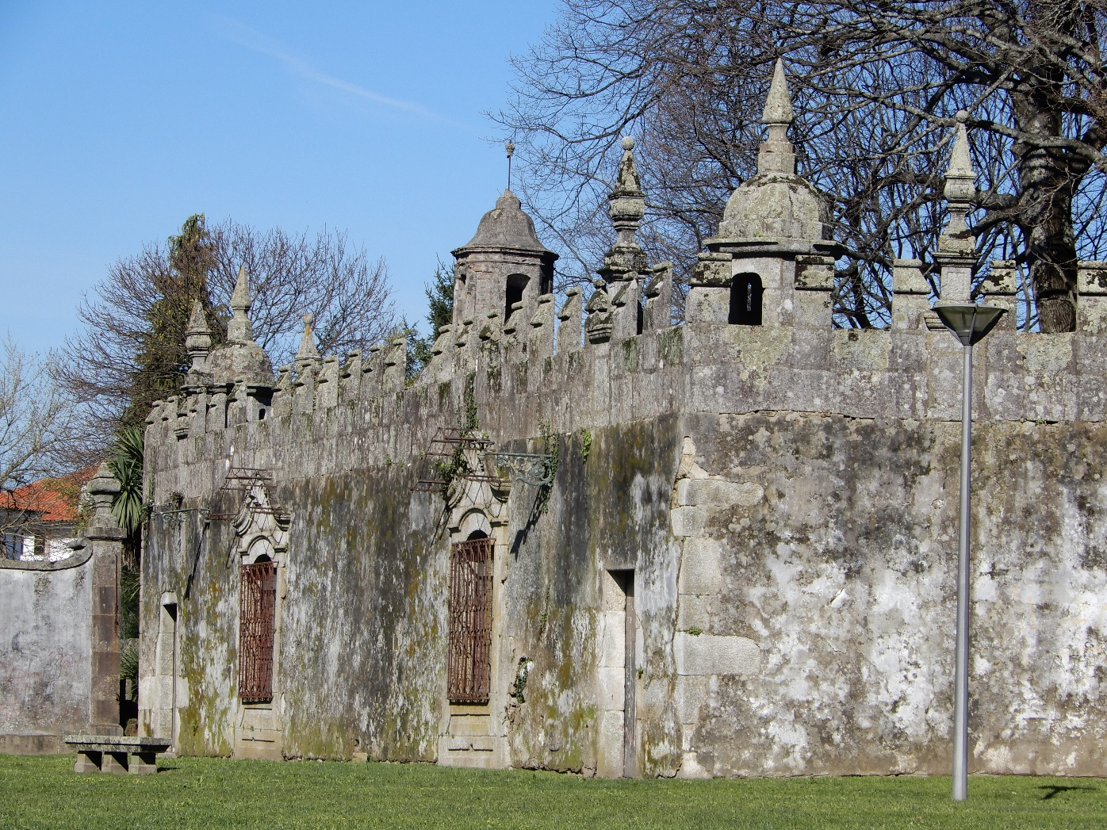
Rough surfaces are an ideal substrate for the growth of microorganisms because they accumulate moisture

Slide 7
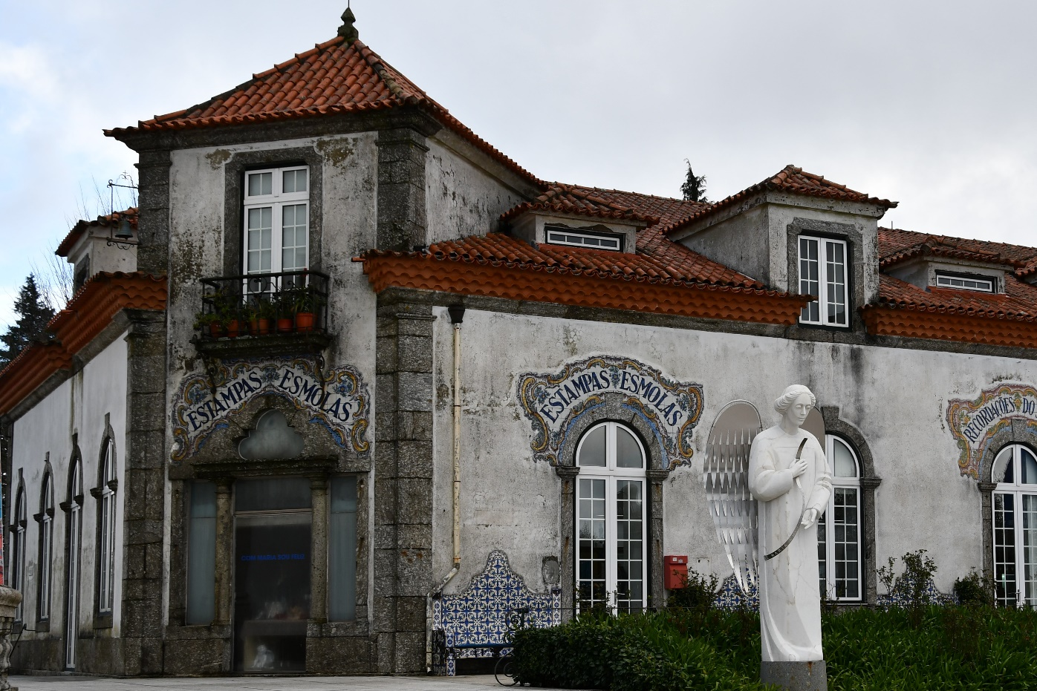
The permeability and water absorption of the facade plaster have an influence on whether biological corrosion will occur

Slide 8
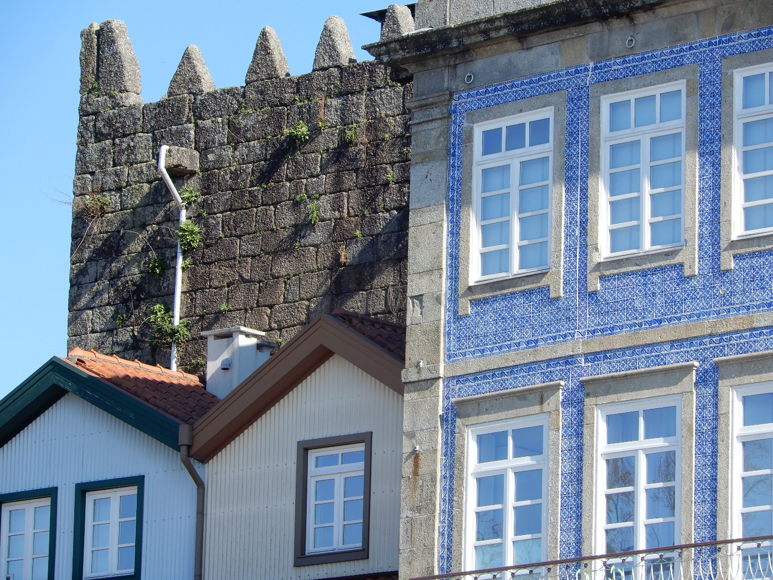
The way the environment influences the building facade can be reduced by using appropriate materials. Plaster and stone can be protected against moisture by impregnation. Plastic facades can also be used.

Slide 9
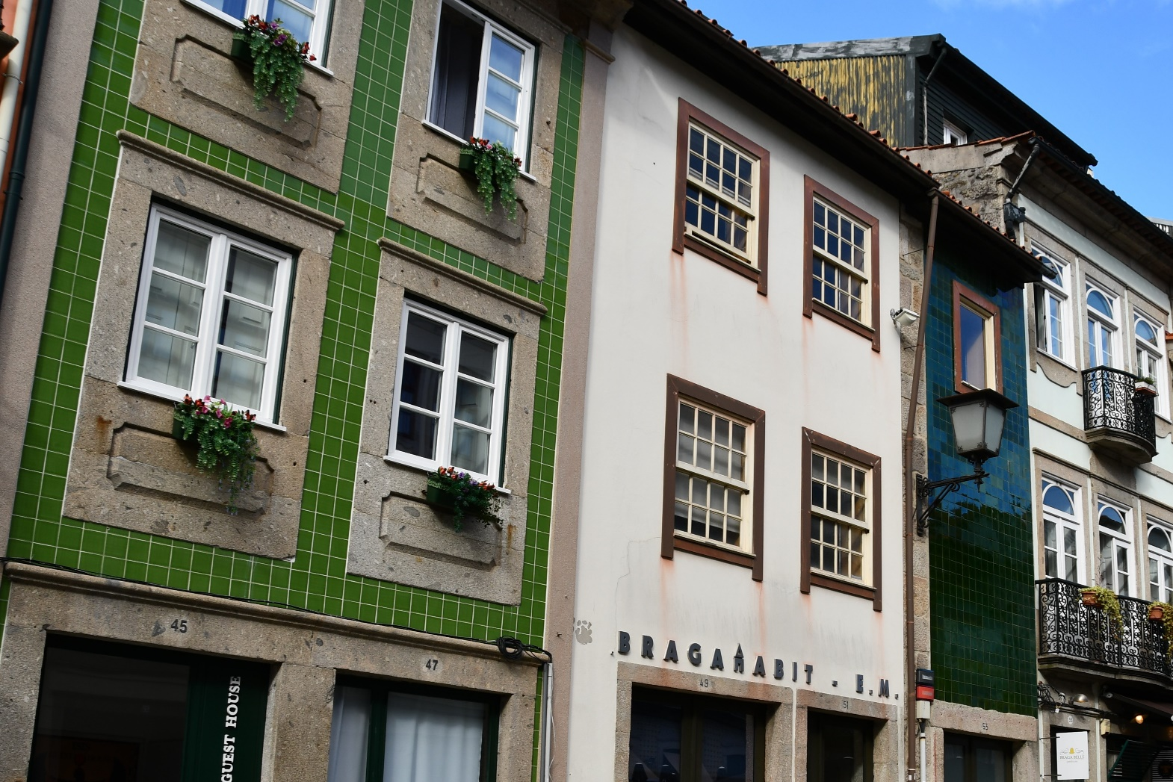
In Portugal, azulejo ceramic tiles are used for facades. They are made of thin, colorful material, often in white and blue. The traditional technique of coating the tiles with a permanent and homogeneous glaze consisted of coating them with a liquid suspension of metal oxides. In order to apply the second layer of glaze, the tiles were placed horizontally on special stands and fired. From the 16th century on, the sizes of tiles were standardized, giving them the form of squares with a side from 13.5 cm to 14.5 cm.

Slide 10
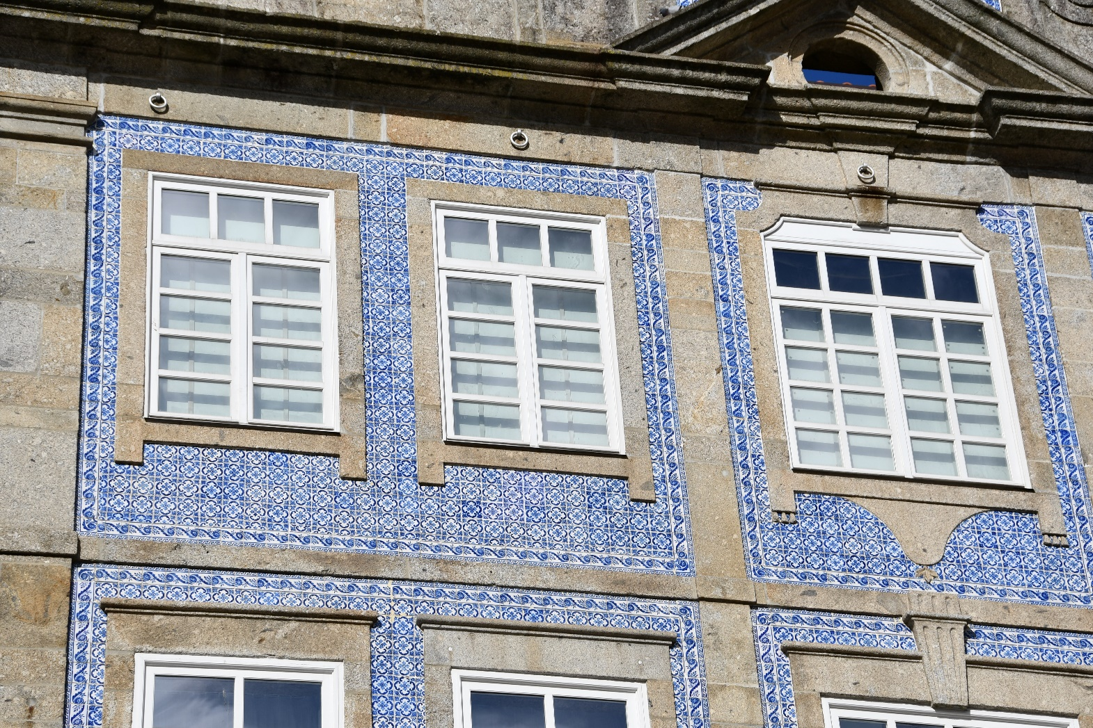
The azulejo tile motif is very distinctive and known all over the world. In summer, the tiles protect against heat, and in winter against moisture. The smooth surface makes it easy to keep clean, and the resistant glaze guarantees resistance to external factors.

Slide 11
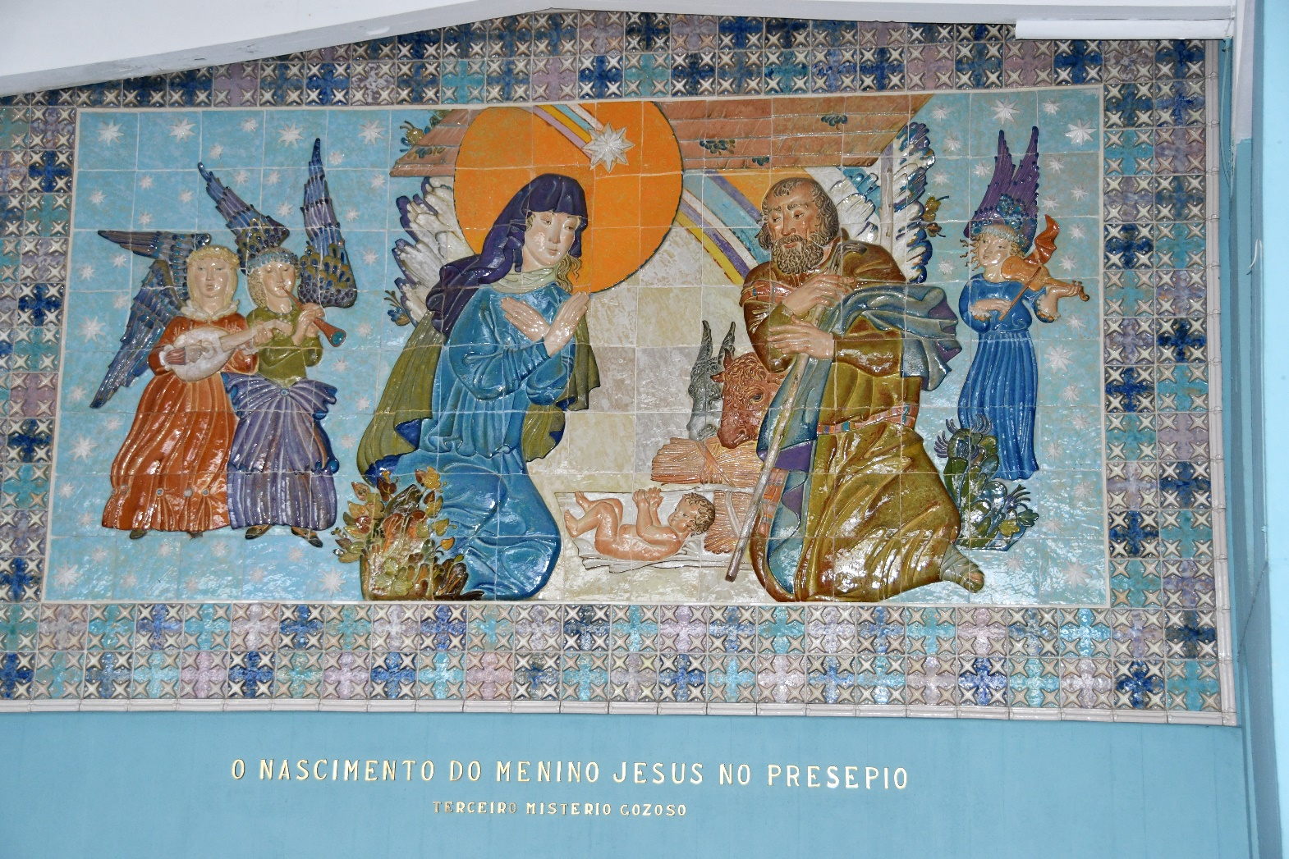
Azulejo tiles were also used in religious architecture

Slide 12
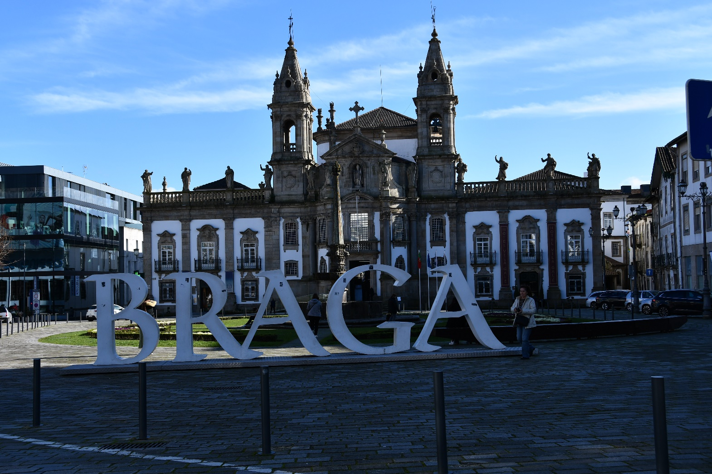
The presentation was prepared during the ERASMUS +internship of teachers in Braga, Portugal in February 2020 (16-22.02.2020)

